Slide 1
Research- Case Studies Identification
31-Aug-2018
Pune
Pratik Shirbhate
pratikshirbhate@gmail.com
+91 7588809138

Slide 2
How do I identify relevant use cases?
New to the Data Science/Analytics Field
Don’t know how to start!
Research! Research! Research
Analyze how data scientists are contributing in healthcare domain
White papers may not be available
Gather/study research papers and reproduce the results
Science-Direct, Elsevier, Academia.edu
Data not available

Slide 3
How do I get the Data?
Have you already identified the problem?
Have your found high level idea to approach to the solution
Where do I get the data?
Get publically available related data from Kaggle, UCI Machine Learning Repository, Data.gov, Data USA, github

Slide 4
Approach
Data Visualization
Data Access
Data Analysis
Data Understanding
Data Integration
Formatting, Cleaning
Storage
Data

Slide 5
Use Case 1- Predict Drug Demand
Demand Forecasting in Pharmaceutical Industry Using Artificial Intelligence: Neuro-Fuzzy Approach
In this study, the actual sales amounts of a pharmaceutical company for seven years period were considered in order to forecast next period’s demands
Determine which products are purchased, where, when, and in what quantities
Researches will not share the data for various reasons
Obtain a sample sales data
Kaggle.com
Synthesize the data based on your needs
This study will help to improve the sales and formulate better marketing strategies

Slide 6
Use Case 2- Predict DME Demand
Extension of use case 1
Identify DME Claims data- Claims explorer
Find pattern in the data
Identify regions where sales of DME was high/low
Forecast the sales and develop marketing strategies
Reinforcement learning-→ Which DMEs are often bought together-→ Give them discount

Slide 7
Use Case 3- Claim Review Prioritization
As of July 2017, HCCI held approximately 1 billion commercial medical and pharmacy claims per year
The finding showed that out of these 1 billion claims submitted, around nine percent of claims were initially denied
5 Million Medical claims are Audited
Random Sampling-→ Not optimal solution
Develop strategy by analyzing denied claims data/pattern
Identify potential claims that are more prone to incorrect denial/over payment/underpayment and route them to auditing systems

Slide 8
Use Case 4- Medical Claim Fraud Detection

Slide 9
Use Case 4- Claim Price Prediction

Slide 10
Use Case 5- Provider/Sales Agent Performance Prediction

Slide 11
Use Case 6- Market Segmentation
Cluster sales of various medical plans demographically

Slide 12
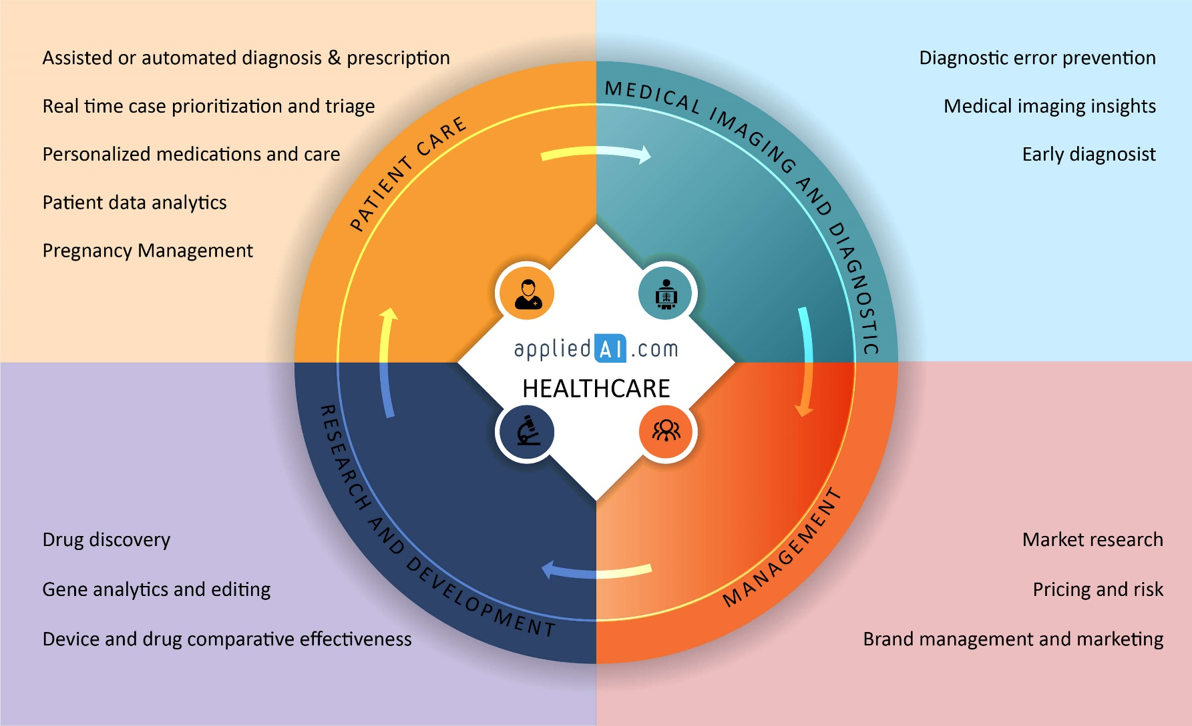
15 AI Applications / Usecases in Healthcare [2018 update] Source-https://blog.appliedai.com/healthcare-ai/

Slide 13
Thank you

